Slide 1
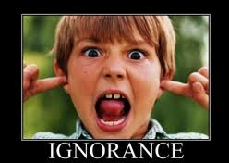
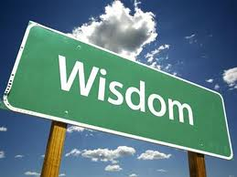
Bildungsroman
By: Skyler Lowman
“ With maturity, you gain perspective and wisdom, but you lose ignorance and innocence.”

Slide 2
Maturity:
“…before Mom and Dad were killed” (Hinton 48).
This quote shows one of the reasons Ponyboy is so mature; he has been forced to grow up and become mature. Ponyboy has been through so much and seen so much that now he is forced to be a mature young adult rather than a reckless child. Darry, obviously, is forced to be much more mature than Ponyboy, since he is the oldest. Also because Darry is the oldest, he is forced to have the pressure to make income and provide for his family. On the other hand, Ponyboy is only fourteen and has to deal with such hardships at such a young age. At this age and with this situation, he is almost forced to become more mature, in his mind, than Darry. Ponyboy, not only has to deal with this hardship, but also the destitution of his gang; also he is only fourteen and in a street gang. These are all ways in which Ponyboy has been forced to become mature; the initial problem, though, was his parents dying in a car accident. This causes Ponyboy to become more mature, even though he is not paying income or providing food for his family, because he has to learn how to rely on his fellow gangs members. Also, Ponboy has to take on more chores and adapt to this major change; as a 13 year old, I would almost never be able to adapt to such a drastic change and be able to comprehend it all together.

Slide 3
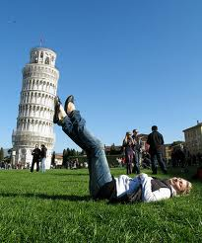
What do you gain?
Perspective:
“Not like the Socs, who jump greasers and wreck houses and throw beer blasts for kicks” (Hinton 3). This is Ponyboy’s first perspective of the Socs and their actions. To Ponyboy, the Socs are petulant and intransigent. In Ponyboy’s perspective, the Socs do what they want because they have money and/or because they think it is fun. Ponyboy obviously disagrees with this concept and believes that because the Socs think like this, then they are the wrong people to associate yourself with.
“’He ain’t a Soc,’ I said, ‘he’s just guy. He just wanted to talk’” (Hinton 118). Later on in the story, Ponyboy got to know the Socs and changed his views of them; he now saw them as normal people. Now that he has matured throughout the book, he has changed his perspective of the Socs to a more civilized view and has realized that they are nice people. Throughout the novel, Ponyboy becomes closer with the Socs and learns that they are really good people beneath this act and all of their money. By comparing these two perspectives, one from the beginning of the novel and one near the end, you can see how maturity brings about perspective; in this case for the better.

Slide 4
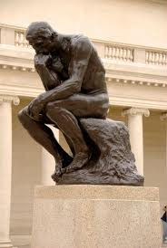
What do you gain?
Wisdom:
“So I figured something was bothering him” (Hinton 172). A synonym for wisdom is understanding. This quote is thought near the end of the book, after we have seen Ponyboy mature. This quote symbolizes wisdom because it shows how Ponyboy has an understanding of others feelings. As Ponyboy becomes more mature he gains so much wisdom; he learns to understand and sense when someone is hurt. Also, when he recognizes that someone is hurt, he does not just leave it alone, he wants to help. Through this quote you see that Ponyboy sense’s how Sodapop is upset, but you do not see what he does to try and fix it; soon after he thinks this quote he asks what is wrong. This shows that Ponyboy is a wiser person by the end of the novel and has the ability to understand more as a character.

Slide 5
What do you lose?
Ignorance:
Innocence:
“Johnny is wanted for murder, and Dallas has a record with the fuzz a mile long” (Hinton 95). This shows how Ponyboy has lost his ignorance by having to know all of this information about his friends. This makes Ponyboy lose his ignorance because he looses his lack of tragic knowledge in order to gain wisdom. Ponyboy must face the truth as he grows up and becomes an adult, he must face the fact that his friends are not perfect and that they have made mistakes in the past that will follow them. As he matures, he must lose his ignorance of the world and of his society in order to gain perspective and wisdom.
“The pillow seemed to sink a little, and Johnny died” (Hinton 148). To witness death is a life scaring event on it’s own and for it to be one of your closest friends makes it even more tragic. When Ponyboy saw Johnny pass away, he lost a lot of his innocence. Earlier in the book Cherry says to Ponyboy “You’ve seen too much to be innocent” (Hinton 26). This quote shows how already Ponyboy has lost his innocence at the beginning of the novel and now he has seen his dearest friend die right in front of him; this takes away his innocence. Just by seeing such a tragic event happen in front of you is the thing that takes away the most of your innocence.

