Slide 1
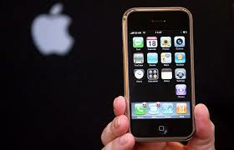
Survival Mode
By: Alexzondra Mattson, Morgan Morris, and Skyler Lowman

Slide 2
What is our idea?
Improve Quality of Life
By creating a setting on Apple Products that can help conserve energy and save your battery life.
Whenever the Lithium-Ion Polymer Battery (Apple Battery), is low (20% or less), it will be able to turn off non-important functions
Will close out any open apps, turn down brightness, turn on auto-brightness, turn off music, and turn down volume.
On average, Apple Products consume around 12 Kilowatt-hours of energy over the course of a year, based on a full charge ever other day. (Kilowatt-hour: A unit of work or energy equal to that expended by one kilowatt in one hour or to 3.6 million joules)

Slide 3
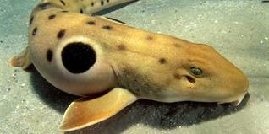
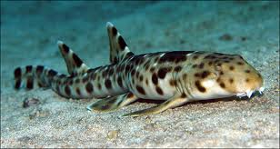
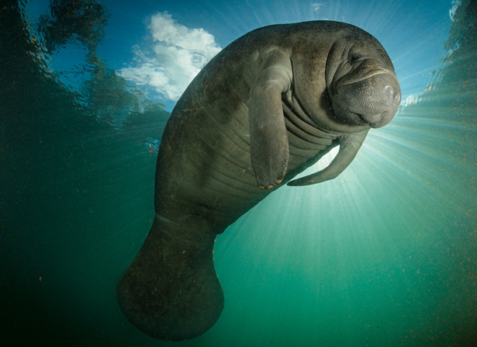
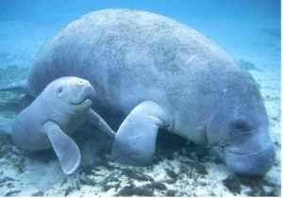
What animals would we use?

Slide 4
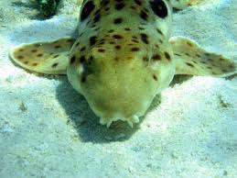
Epaulette Shark
Habitat:
Found in shallow coral reefs off the coast of Australia
Migration Patterns:
Stay near local habitat because food source is non-migratory
Not physically able to swim long distances
Life Cycle:
When born sharks are 15 cm long
Females mature at 64.3 cm
Males mature at 59- 62 cm
Life expectancy: 25 years

Slide 5
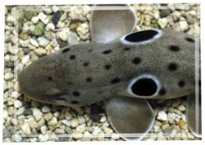
Epaulette Sharks Cont.
Negative Impacts:
Being collected for museum trade
Accidentally caught when people fish
Coral reefs are being damaged
“Near Threatened” around New Guinea
Special Attributes:
In low oxygen areas can turn off non-vital functions
“False Eye”: Used to blend in with natural surrounding

Slide 6
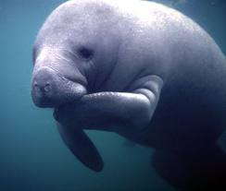
Manatee
Habitat:
Warm tropical and subtropical water
Can live in fresh, saline, and brackish water
Migration Patterns:
Mainly move to warm waters
Migrate south into warmer waters during colder months
Life Cycle:
Females mature at 5 years
Males mature at 9 years
One calf born at a time, weighs 60-70 lbs and is 3-4 feet in length at birth

Slide 7
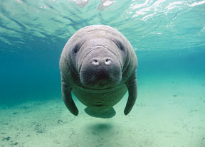
Manatees Cont.
Negative Impacts:
Considered Endangered
More than 41% of manatee deaths were human related and almost 34% were due to watercraft collisions
Illegal to harass, hunt, capture, or kill a marine mammal (manatees) due to the Endangered Species Act of 1973
Special Attributes:
Can “sleep walk”: Conserve energy while it’s sleeping, but can still preform necessary functions.
“Sea Cow”

Slide 8
Create!!!
Materials:
Design Team
Create a new phone with this feature (Iphone 4sb) [Saves Battery]
Computers and Technology to create this feature
SIM Cards
Plan:
1. Hire design team with job interviews
2. Create SIM Cards that contain the feature
3. Install SIM Cards in phones
4. Market and advertise product

Slide 9
Bibliography
Kappus, N. “Hemiscyllium Ocellatum (Bonnaterre, 1788).” Education Life Desks. Encyclopedia of Life, Jan. 26. Web. 23 May 2013.
Malik, Om. “How Much Energy Does it Take to Power Those IPads?- Tech New and Analysis.” GigaOm. N.P., 21 June 2012. Web. 30 May 2013.
"Kilowatt-hour - Definition and More from the Free Merriam-Webster Dictionary."Dictionary and Thesaurus - Merriam-Webster Online. N.p.,n.d. Web. 30 May 2013. <http://www.merriam-webster.com/dictionary/kilowatt-hour>.
“Manatees.” Animals: Explore Discover Connect. Busch Gardens, Sea World, Discovery Cove, N.D., Web. 23 May 2013.
“The Insite- Endangered Species: Manatee.” Spaceship Earth. Save the Manatee Club, 15 Aug. 2009. Web. 23 May 2013.

